Slide 1
Multilayer perceptron
Weight initialization

Slide 2




Multilayer perceptron(MLP)
Fully Connected Network
No of layers
No of biases
No of Parameters(weights and biases)
Activation function?
$$L_{3}$$
$$L_{0}$$
$$L_{2}$$
$$L_{1}$$

Slide 3
Training MLP
Initialize the model weights and biases
Choose optimization algorithm
For every epoch
For every batch
Compute the output
Compute the error
Compute the gradient of loss wrt to model parameters
Update model parameters(based on optimization algorithm)

Slide 4
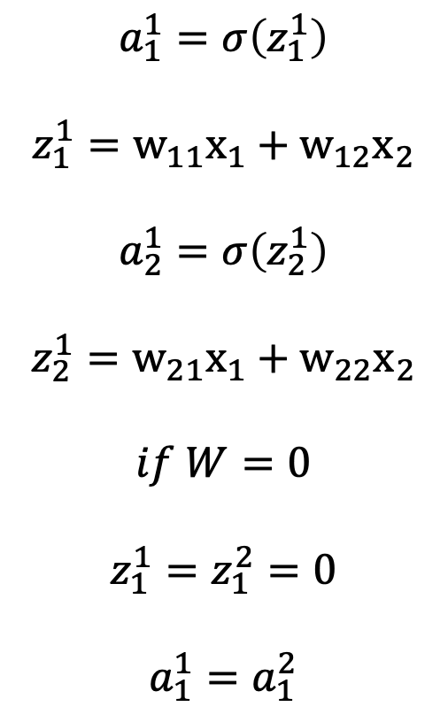
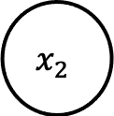

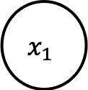
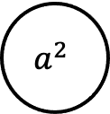
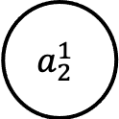
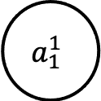
Why no to initialize the weight to zero?
$$x_{1}$$
$$a_{1}^{1}$$
$$a_{1}^{1}=σ\left(z_{1}^{1}\right)$$
$$z_{1}^{1}=w_{11}x_{1}+w_{12}x_{2}$$
$$a_{2}^{1}=σ\left(z_{2}^{1}\right)$$
$$z_{2}^{1}=w_{21}x_{1}+w_{22}x_{2}$$
$$if W=0$$
$$z_{1}^{1}=z_{1}^{2}=0$$
$$a_{1}^{1}=a_{1}^{2}$$
$$a^{2}$$
W
$$x_{2}$$
$$a_{2}^{1}$$
$$W=\left[\begin{matrix}w_{11} & w_{12} \\ w_{21} & w_{22}\end{matrix}\right]$$

Slide 5
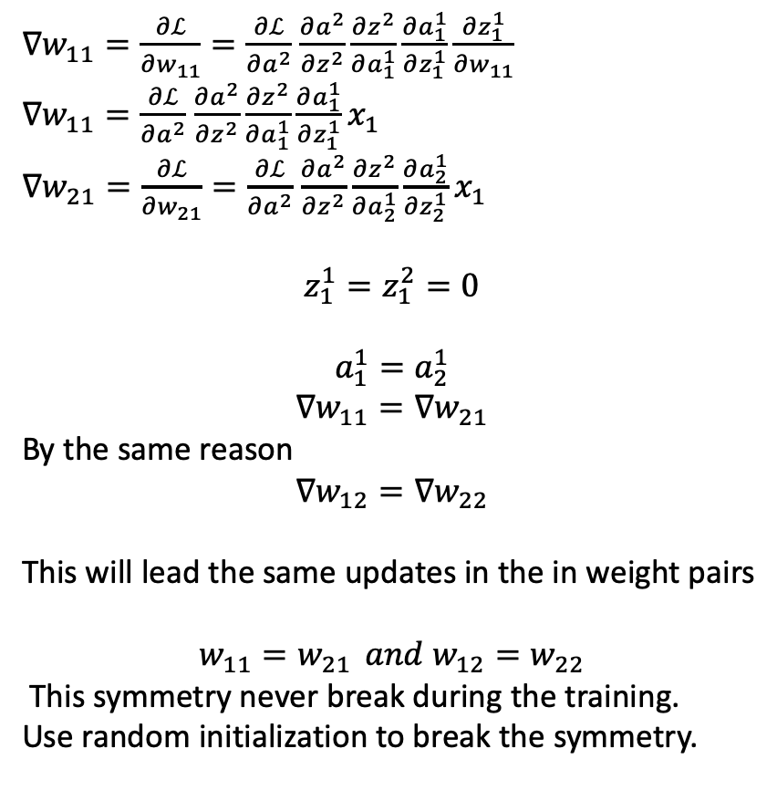
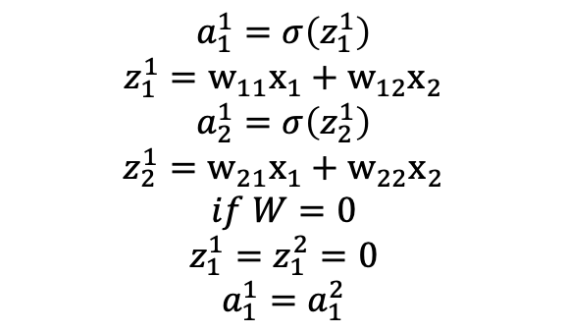

Why not to initialize the weight to zero or constant?
$∇w_{11}=\frac{∂ℒ}{∂w_{11}}=\frac{∂ℒ}{∂a^{2}}$ $\frac{∂a^{2}}{∂z^{2}}\frac{∂z^{2}}{∂a_{1}^{1}}\frac{∂a_{1}^{1}}{∂z_{1}^{1}}\frac{∂z_{1}^{1}}{∂w_{11}}$
$∇w_{11}=\frac{∂ℒ}{∂a^{2}}$ $\frac{∂a^{2}}{∂z^{2}}\frac{∂z^{2}}{∂a_{1}^{1}}\frac{∂a_{1}^{1}}{∂z_{1}^{1}}x_{1}$
$∇w_{21}=\frac{∂ℒ}{∂w_{21}}=\frac{∂ℒ}{∂a^{2}}$ $\frac{∂a^{2}}{∂z^{2}}\frac{∂z^{2}}{∂a_{2}^{1}}\frac{∂a_{2}^{1}}{∂z_{2}^{1}}x_{1}$
$$z_{1}^{1}=z_{1}^{2}=0$$
$$a_{1}^{1}=a_{2}^{1}$$
$$∇w_{11}=∇w_{21}$$
By the same reason
$$∇w_{12}=∇w_{22}$$
This will lead the same updates in the in weight pairs
$$w_{11}=w_{21 } and w_{12}=w_{22}$$
This symmetry never break during the training.
Use random initialization to break the symmetry.
$$x_{1}$$
$$a_{1}^{1}$$
$$a^{2}$$
$$ℒ(a^{2},y)$$
W
$$x_{2}$$
$$a_{2}^{1}$$
$$a_{1}^{1}=σ\left(z_{1}^{1}\right)$$
$$z_{1}^{1}=w_{11}x_{1}+w_{12}x_{2}$$
$$a_{2}^{1}=σ\left(z_{2}^{1}\right)$$
$$z_{2}^{1}=w_{21}x_{1}+w_{22}x_{2}$$
$$if W=0$$
$$z_{1}^{1}=z_{1}^{2}=0$$
$$a_{1}^{1}=a_{1}^{2}$$

Slide 6






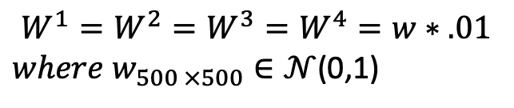


What if weights are initialized randomly? Small Weights
x
$${σ(z}^{1})$$
$${σ(z}^{2})$$
$${σ(z}^{2})$$
$${σ(z}^{3})$$
$$W^{1}$$
$$W^{2}$$
$$W^{3}$$
$$W^{4}$$
$$W^{1}=W^{2}=W^{3}=W^{4}=w∗.01$$
$where w_{500 ×500}∈𝒩$(0,1)

Slide 7
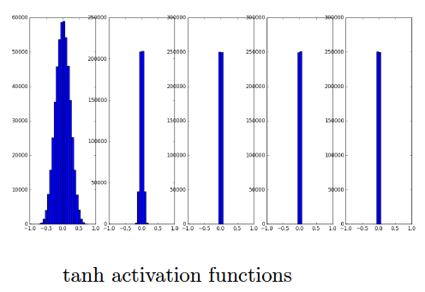








What if weights are initialized randomly? Forward Pass:
x
$${σ(z}^{1})$$
$${σ(z}^{2})$$
$${σ(z}^{2})$$
$${σ(z}^{3})$$
$$W^{1}$$
$$W^{2}$$
$$W^{3}$$
$$W^{4}$$

Slide 8
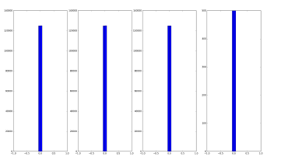








What if weights are initialized randomly? Backward pass:
x
$${σ(z}^{1})$$
$${σ(z}^{2})$$
$${σ(z}^{2})$$
$${σ(z}^{3})$$
$$W^{1}$$
$$W^{2}$$
$$W^{3}$$
$$W^{4}$$
http://www.cse.iitm.ac.in/~miteshk/CS7015/Slides/Handout/Lecture9.pdf

Slide 9
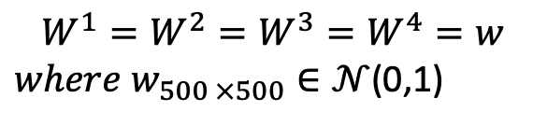
What if weights are initialized randomly? Large Weights
x
$${σ(z}^{1})$$
$${σ(z}^{2})$$
$${σ(z}^{2})$$
$${σ(z}^{3})$$
$$W^{1}$$
$$W^{2}$$
$$W^{3}$$
$$W^{4}$$
$$W^{1}=W^{2}=W^{3}=W^{4}=w$$
$where w_{500 ×500}∈𝒩$(0,1)

Slide 10
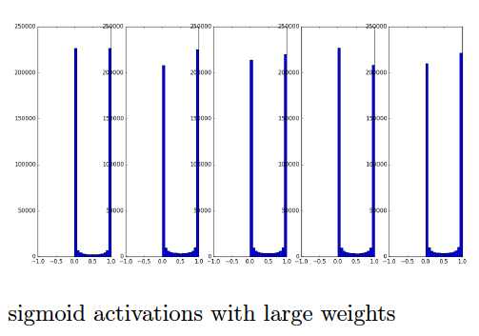
What if weights are initialized randomly? Forward Pass:
x
$${σ(z}^{1})$$
$${σ(z}^{2})$$
$${σ(z}^{2})$$
$${σ(z}^{3})$$
$$W^{1}$$
$$W^{2}$$
$$W^{3}$$
$$W^{4}$$
http://www.cse.iitm.ac.in/~miteshk/CS7015/Slides/Handout/Lecture9.pdf

Slide 11
What did we learn from the last experiments?
Network should not be initialize to the zero or constant weights.
Network should not be initialize with the large weights.
Network should not be initialize to the smaller weights.
Mean of the activation should be zero.
Variance in the activations should remain almost same in all the layers.

Slide 12

Statistics Refresher
$var\left(x+y\right)=var\left(x\right)+var(y)$
$var\left(ax\right)=a^{2}var\left(x\right) if a is a constant$
$var\left(xy\right)=var\left(x\right)var\left(y\right) if x and y are independant$

Slide 13
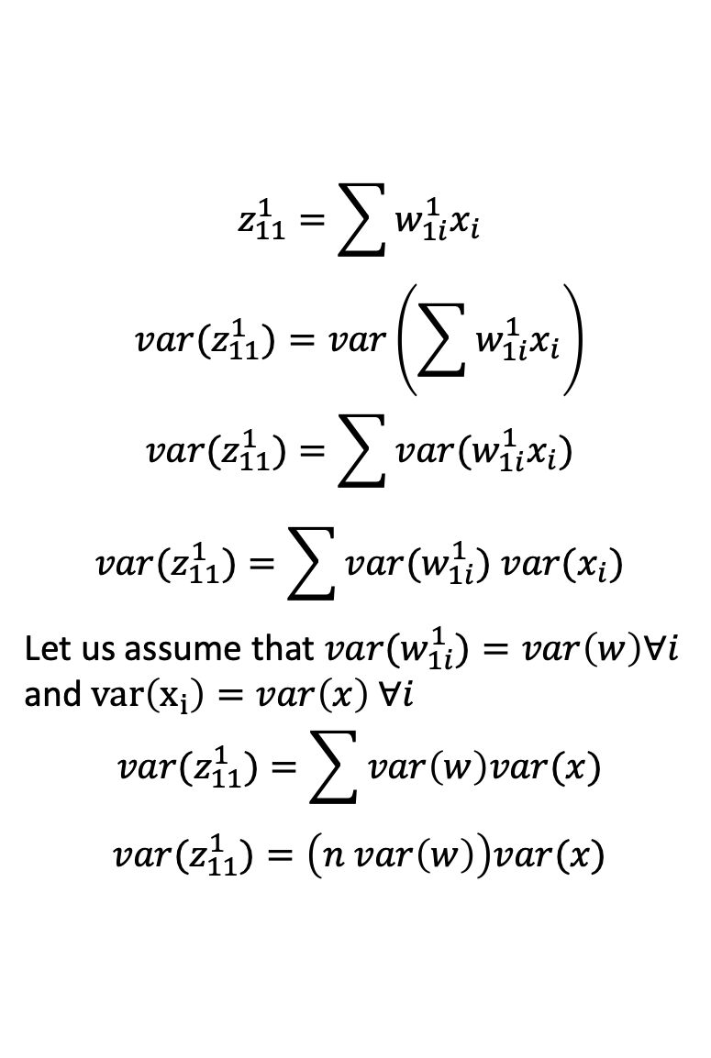
How to ensure the same variance in the activations across the layers?
$$z_{11}^{1}=\sum{w_{1i}^{1}x_{i}}$$
$${var(z}_{11}^{1})=var\left(\sum{w_{1i}^{1}x_{i}}\right)$$
$${var(z}_{11}^{1})=\sum{{var(w}_{1i}^{1}x_{i})}$$
$${var(z}_{11}^{1})=\sum{{var(w}_{1i}^{1}{) var(x}_{i})}$$
Let us assume that ${var(w}_{1i}^{1})=var\left(w\right)∀i$
and $var\left(x_{i}\right)=var\left(x\right) ∀i$
$${var(z}_{11}^{1})=\sum{var\left(w\right)var(x)}$$
$${var(z}_{11}^{1})=\left(n var\left(w\right)\right)var(x)$$
.
.
.
. . .
. . .
. . .

Slide 14
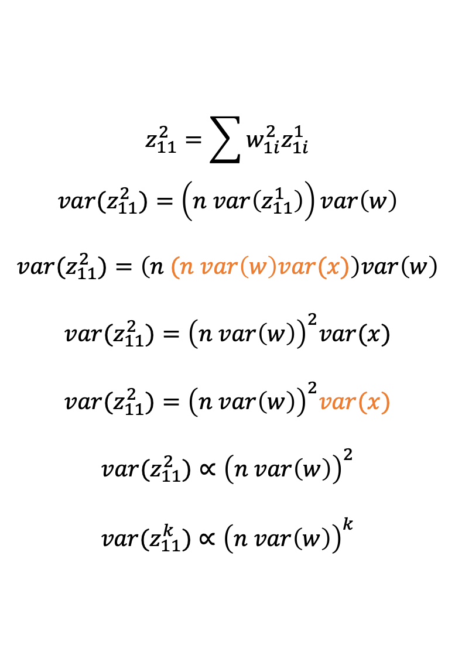
How to ensure the same variance in the activations across the layers?
$$z_{11}^{2}=\sum{w_{1i}^{2}z_{1i}^{1}}$$
$${var(z}_{11}^{2})=\left(n var\left(z_{11}^{1}\right)\right)var\left(w\right)$$
$${var(z}_{11}^{2})=\left(n (n var\left(w\right)var(x)\right)var\left(w\right)$$
$${var(z}_{11}^{2})={\left(n var\left(w\right)\right)}^{2}var(x)$$
$${var(z}_{11}^{2})={\left(n var\left(w\right)\right)}^{2}var(x)$$
$${var(z}_{11}^{2})∝{\left(n var\left(w\right)\right)}^{2}$$
$${var(z}_{11}^{k})∝{\left(n var\left(w\right)\right)}^{k}$$
.
.
.
. . .
. . .
. . .

Slide 15
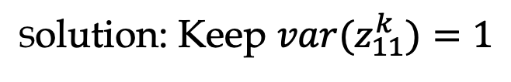

How to ensure the same variance in the activations across the layers?
$${var(z}_{11}^{k})∝{\left(n var\left(w\right)\right)}^{k}$$
What happens if var(w)>>1?
What happens if var(w)<<1?
Solution: Keep ${var(z}_{11}^{k})=1$

Slide 16
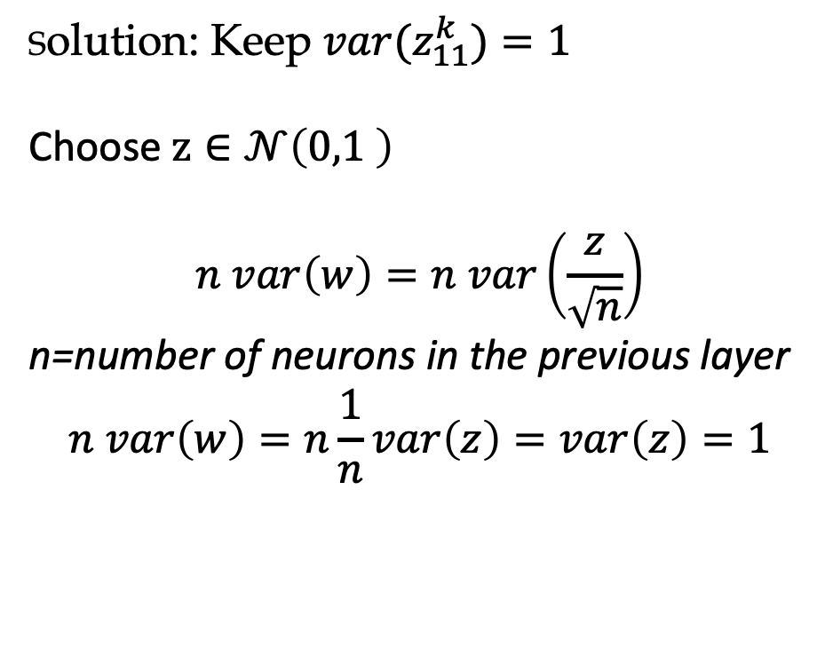
How to ensure the same variance in the activations across the layers?
Solution: Keep ${var(z}_{11}^{k})=1$
Choose $z∈𝒩\left(0,1 \right)$
$$n var\left(w\right)=n var\left(\frac{z}{\sqrt{n}}\right)$$
n=number of neurons in the previous layer
$$n var\left(w\right)=n\frac{1}{n}var\left(z\right)=var\left(z\right)=1$$

Slide 17
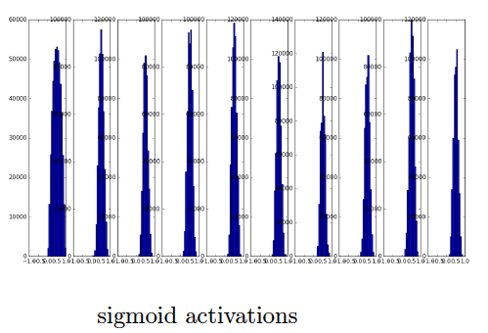
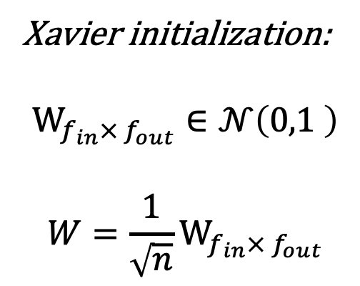
How to Choose the weight?
Xavier initialization:
$$W_{f_{in}× f_{out}}∈𝒩\left(0,1 \right)$$
$$W=\frac{1}{\sqrt{n}}W_{f_{in}× f_{out}}$$

Slide 18
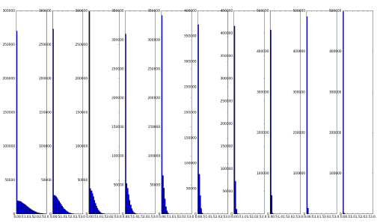
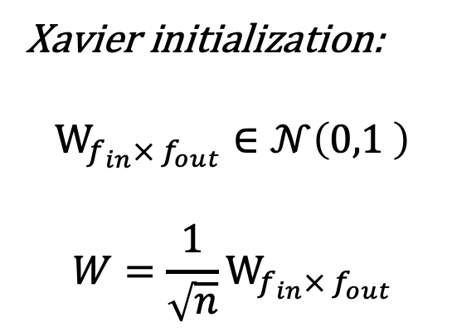
How to Choose the weight?
Xavier initialization:
$$W_{f_{in}× f_{out}}∈𝒩\left(0,1 \right)$$
$$W=\frac{1}{\sqrt{n}}W_{f_{in}× f_{out}}$$
Relu Activations

Slide 19
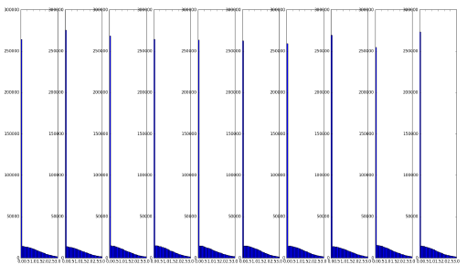
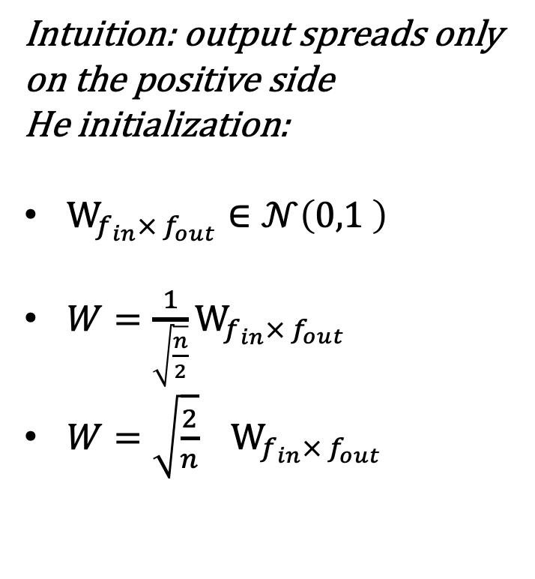
How to Choose the weight? Relu Activation:
Intuition: output spreads only on the positive side
He initialization:
$W_{f_{in}× f_{out}}∈𝒩\left(0,1 \right)$
$W=\frac{1}{\sqrt{\frac{n}{2}}}W_{f_{in}× f_{out}}$
$W=\sqrt{\frac{2}{n}}{ W}_{f_{in}× f_{out}}$
Relu Activations

